Slide 1

Trust-Based Recommendation
Sponsored by
Team NASA
Neeraj Saini, Pujita Rao, Shuai Wang and Venkatesh Sriram
Advisor : Dr. Jia Zhang
Collaborator : Chris Lee(Ph.D. Student)
Client : Petr Votava (NASA)
Thursday, Dec 5, 2013
Notes:
Client/Sponsor
Check: Camelcase Headings and Consistency
Insert: Page Numbers and Date

Slide 2
Agenda
Introduction
Implementation Modules
Demo
Team Dynamics
Lessons Learned
Conclusion
Future Work
Notes:
no sub topics

Slide 3
Introduction
BACKGROUND
SPONSORS
PROBLEM STATEMENT
GOALS

Slide 4
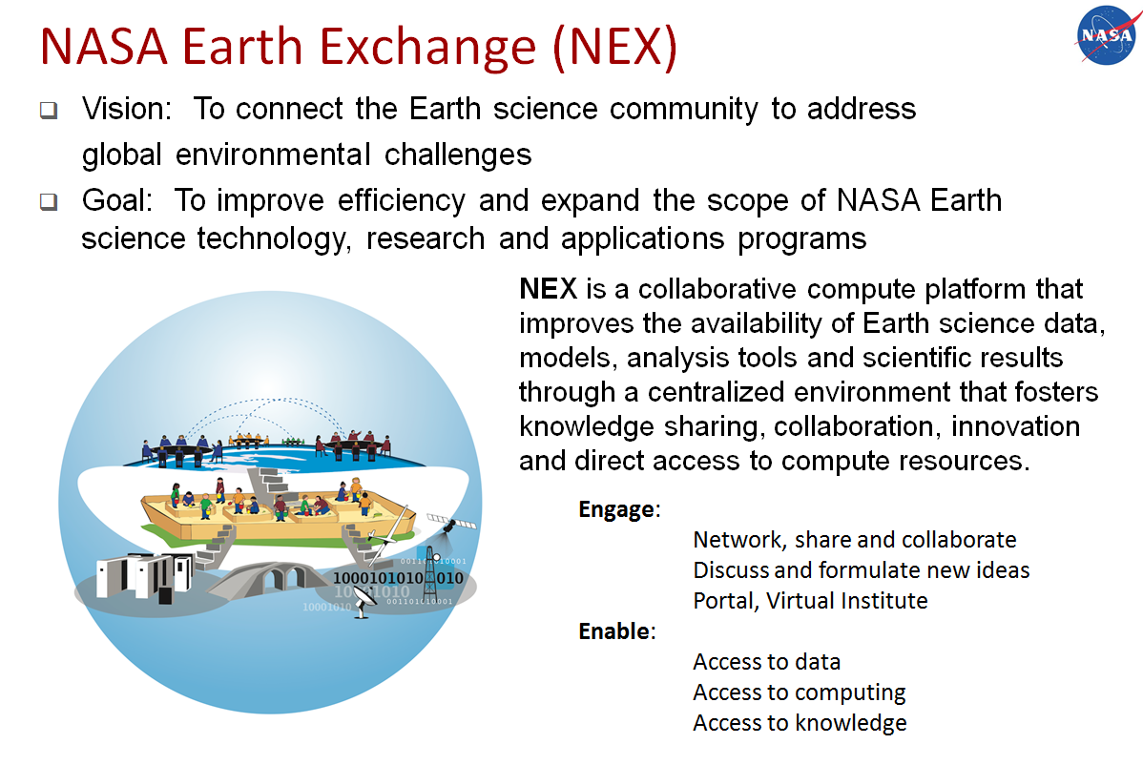
BACKGROUND
BACKGROUND
SPONSORS
PROBLEM STATEMENT
GOALS

Slide 5
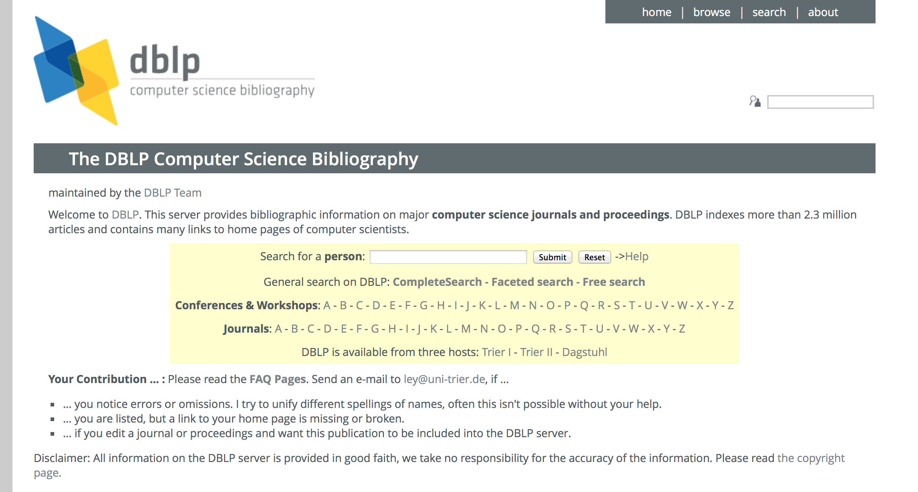
BACKGROUND
BACKGROUND
SPONSORS
PROBLEM STATEMENT
GOALS
Notes:
Last year’s practicum team build a human-trust model.

Slide 6
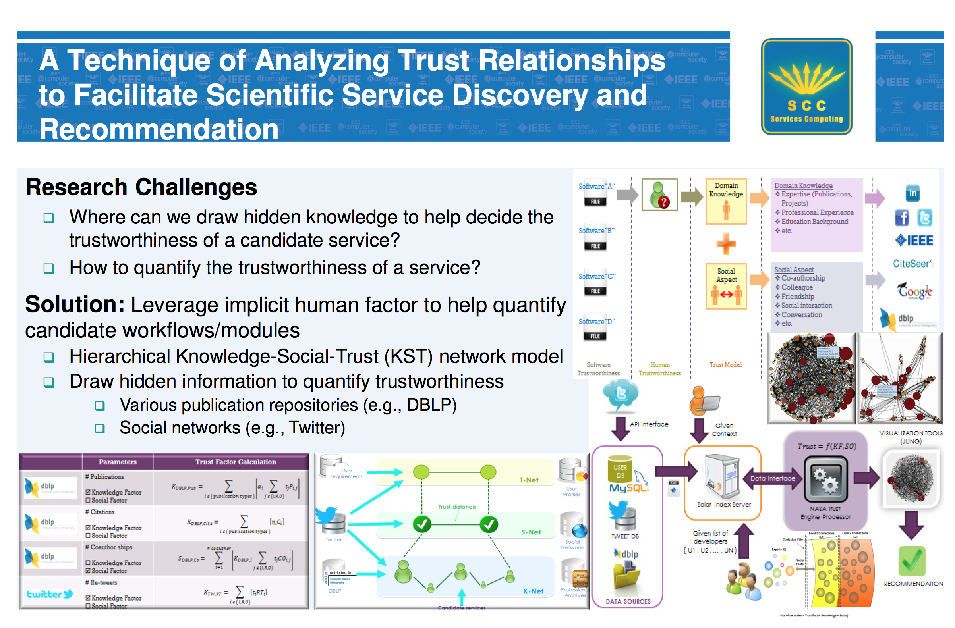
BACKGROUND
BACKGROUND
SPONSORS
PROBLEM STATEMENT
GOALS
Notes:
Last year’s practicum team build a human-trust model.

Slide 7
CLIENT RELATIONS
Project kickoff with meetings scientists for clear vision.
Very accommodating with the schedule.
Advantage of working for NASA in NASA park.
Valuable feedback helped steering the project
BACKGROUND
SPONSORS
PROBLEM STATEMENT
GOALS
Notes:
no sub topics

Slide 8
PROBLEM STATEMENT
NASA’s Domain Scientists currently lack tools that can effectively help them find fellow researchers with whom they can collaborate, ask questions and get help from, as they share a common interest group.
BACKGROUND
SPONSORS
PROBLEM STATEMENT
GOALS
Notes:
recommend workflows

Slide 9
goal
Based on human trust
REST API and stand-alone service
Integrate with NASA workflow tool
Use a similar dataset like DPLB
Build a self-learning recommendation engine for scientists that finds the likelihood of two scientists to co-author.
BACKGROUND
SPONSORS
PROBLEM STATEMENT
GOALS
Notes:
should “machine learning algorithms for probability” be a goal? Can we write something like “system should be self learning”?

Slide 10
IMPLEMENTATION MODULES
MACHINE LEARNING APPROACH
DATA SOURCES
COLLABORATION PROBABILITY USING ML
PERFORMANCE MEASURES

Slide 11
PROBLEM TO BE SOLVED
Given two authors, find the probability that these authors will collaborate with each other (help each other)
Why?
The major factor in recommendation of a tool is if the creator of the tool is someone who is likely to help you
MACHINE LEARNING APPROACH
DATA SOURCES
COLLABORATION PROBABILITY USING ML
PERFORMANCE MEASURES

Slide 12
MACHINE LEARNING APPROACH
Get dataset
Get input from user
Run machine learning algorithm
Parse and format data
Training data
Generate training data
Generate output

Slide 13
DATASET
The DBLP Computer Science Bibliography (http://dblp.uni-trier/xml/)
2.3 Million publications dating back to 1936. Consistently updated since the 1980’s
Considered the definitive publication bibliography in Computer Science
MACHINE LEARNING APPROACH
DATA SOURCES
COLLABORATION PROBABILITY USING ML
PERFORMANCE MEASURES

Slide 14
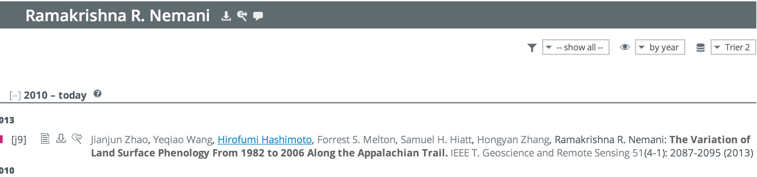
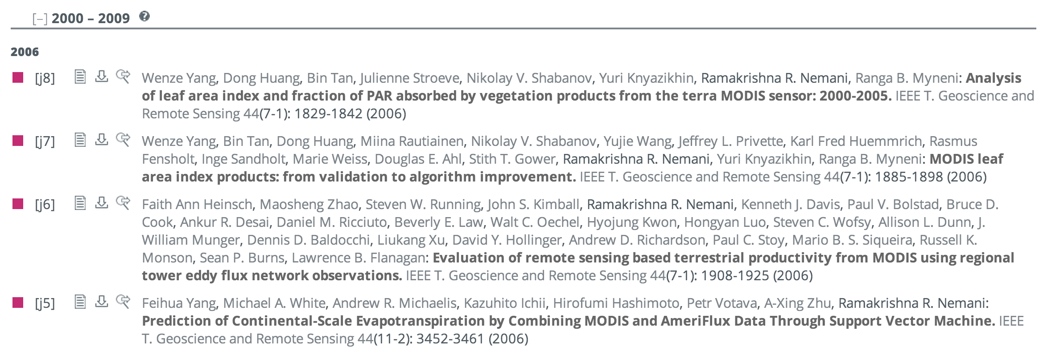
WHY DBLP?
Readily available and complete dataset.
Useful for building proof of concept before using actual Earth Science data
Also contains a large number of Earth Science articles
SEARCH RESULTS FOR RAMAKRISHNA NEMANI, SENIOR EARTH SCIENTIST, NASA AMES
MACHINE LEARNING APPROACH
DATA SOURCES
COLLABORATION PROBABILITY USING ML
PERFORMANCE MEASURES

Slide 15
ANALYSIS OF COMPLETE DATASET
Nature of dataset : XML file of size 1.2 GB.
Parsing challenges:
Estimated Time taken
Time taken to create Co-Author Graph (explained later) on full DBLP file ≈ 22 minutes (using a Macbook Pro with 8GB RAM and 2.6 GHz core i5)
Estimated number of such calculations required for complete dataset ≈ 6 million
Thus, estimated time taken on our machine≈ 250 years!
MACHINE LEARNING APPROACH
DATA SOURCES
COLLABORATION PROBABILITY USING ML
PERFORMANCE MEASURES

Slide 16
ANALYSIS OF COMPLETE DATASET
Additional challenges:
Possibility of Overfitting
A learning algorithm is said to Overfit, if it is more accurate in fitting known data (hindsight) but less accurate in predicting new data (foresight).
Usually occurs due to rare examples that may have no causal relation to target function.
Some author pairs are very unlikely to coauthor (due to different research interests or different time frames). The data calculation for these author pairs could cause Overfitting.
MACHINE LEARNING APPROACH
DATA SOURCES
COLLABORATION PROBABILITY USING ML
PERFORMANCE MEASURES

Slide 17
STRATEGY
Focus on one particular research area (such as distributed systems)
Smaller but complete dataset (for the domain)
Took all publications related to Distributed Systems (1900 publications and 1082 distinct authors)
Advantage: We can expect convincing and representative results due to completeness of dataset within the matched domain.
MACHINE LEARNING APPROACH
DATA SOURCES
COLLABORATION PROBABILITY USING ML
PERFORMANCE MEASURES

Slide 18
DATA MODIFICATION APPROACH
COMPLETE DATASET
2.3 Million Publications
1.2 GB
CSV REPRESENTATION
Parse relevant dataset XML using JAXB
Create CSV representation using parsed data
MySQL DATABASE REPRESENTATION
Create Relational database schema
Import CSV file into MySQL using MySQL workbench
RELEVANT DATASET
Related to Distributed systems
1900 publications
1082 distinct authors
Related to lots of research areas

Slide 19
GENERATING TRAINING DATA
Modeling the problem-
Given the collaboration history of a huge set of authors, find out the factors that affect their willingness to collaborate, and fit those factors in a machine learning model.
MACHINE LEARNING APPROACH
DATA SOURCES
COLLABORATION PROBABILITY USING ML
PERFORMANCE MEASURES

Slide 20
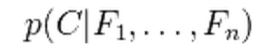
NAÏVE BAYES network
Classification algorithm for calculating the probability of an outcome.
Suitable for problems where a small set of features affect final outcome, and these features are independent of each other.
Classifies the output as one out of a small set of possibilities.
Formal definition-
The probability model is a conditional model
C – Output with small set of possibilities
F₁….F_{n} – Independent input features
MACHINE LEARNING APPROACH
DATA SOURCES
COLLABORATION PROBABILITY USING ML
PERFORMANCE MEASURES

Slide 21
OUR HYPOTHESIS
The likelihood of co-authorship can be modeled as a Naïve Bayes classification problem.
p(C| F₁, F₂, F₃ ,F₄, F₅)
Output (C) - Probability that two authors will co-author.
Independent input features-
F₁- Similarity of research areas
F₂- Similarity of author reputation
F₃- Author connectedness
F₄- Collaboration history of each author
F₅- Work interaction strength
MACHINE LEARNING APPROACH
DATA SOURCES
COLLABORATION PROBABILITY USING ML
PERFORMANCE MEASURES

Slide 22
Naïve Bayes classifier
Similarity of research areas
Similarity of author reputation
Author connectedness
Collaboration history of each author
Work interaction strength
H/M/L
H/M/L
H/M/L
H/M/L
H/M/L
H – High
M – Medium
L - Low
REPRESENTATION OF OUR HYPOTHESIS
Likelihood of collaboration

Slide 23
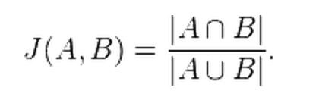
JACCARD SIMILARITY
Statistic used for comparing the similarity and diversity of input sets.
Given two sets of inputs, it outputs a percentage similarity between the two sets.
Formal definition-
Let A and B be the input sets, J(A,B) is the Jaccard similarity of the two sets.
It is represented by-

Slide 24
F1 - SIMILARITY OF RESEARCH AREAS
Rationale- Two authors are more likely to co-author when they share the same research areas.
Modeling the problem-
Given two authors and their publication information, calculate the similarity of their past areas of research interest
MACHINE LEARNING APPROACH
DATA SOURCES
COLLABORATION PROBABILITY USING ML
PERFORMANCE MEASURES

Slide 25
HYPOTHESIS FOR RESEARCH AREA SIMILARITY
Get Author 1 publication titles
Extract keywords
Author 1 keywords
Calculate Jaccard Similarity
Get research area similarity
Extract keywords
Author 2 keywords
Get Author 2 publication titles

Slide 26
F1 - SIMILARITY OF RESEARCH AREAS
Get author publication keywords
Calculate Jaccard Similarity
Classify into H (high similarity), M (Medium similarity) and Low (Low Similarity)
APPROACH FOR CALCULATING RESEARCH SIMILARITY

Slide 27
F2 - SIMILARITY OF AUTHOR REPUTATION
Rationale- Two people are more likely to co-author with each other if their reputation in the field is similar i.e. a person with high reputation is more likely to collaborate with another person with high reputation, and vice versa.
Assumption- We consider the number of cases of a professor co-authoring with a student as sufficiently small.
MACHINE LEARNING APPROACH
DATA SOURCES
COLLABORATION PROBABILITY USING ML
PERFORMANCE MEASURES

Slide 28
F2 - SIMILARITY OF AUTHOR REPUTATION
CALCULATE THE REPUTATION OF EACH AUTHOR
Based on work done by NASA practicum team of 2012
CALCULATE ABSOLUTE VALUE OF DIFFERENCE BETWEEN THE REPUTATIONS
Indicator about authors’ reputation similarity
CLASSIFY THE SIMILARITY
High (very similar)
Medium
Low (very different)
APPROACH FOR CALCULATING AUTHOR REPUTATION SIMILARITY

Slide 29
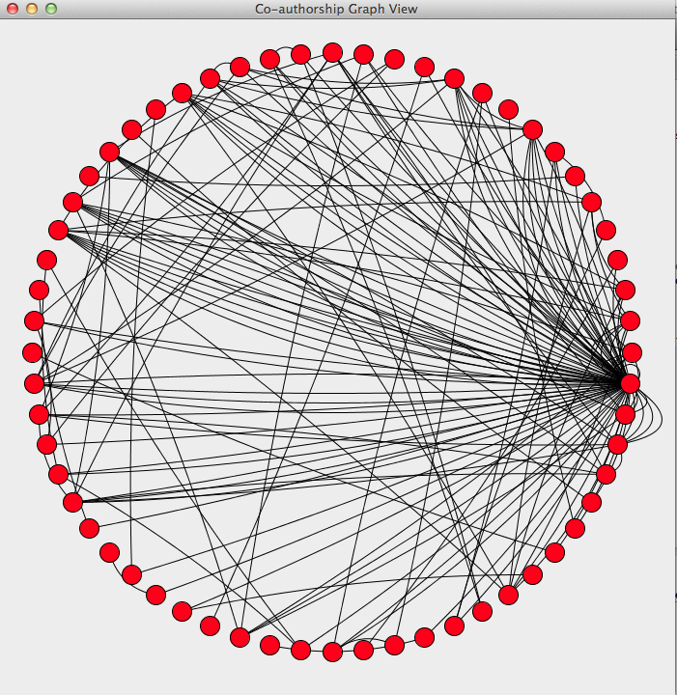
CO-AUTHOR GRAPH
Formal definition-
We can represent Co-authorship as a Graph G = (V , E), such that
V is Vertex Set, each vertex is an Author
E is Edge set, where an Edge exists between two authors, if they have Co-Authored on anything in the past.
Fig: CO-AUTHOR GRAPH FOR 91 AUTHORS FROM THE DBLP DATASET
Node -> Author
Edge -> Co-authorship

Slide 30
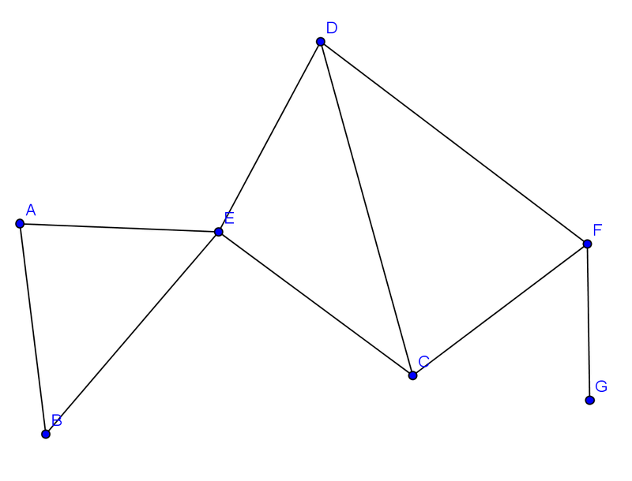
CO-AUTHOR GRAPH
Explanation-
Let a sub-graph of the Co-Author graph be represented by the following
Authors– A,B,C,D,E,F
Past Co-Authorship exists between-
A and B,
A and E,
B and E,
C and D,
C and E,
C and F,
D and E,
D and F,
F and G

Slide 31
F3 - AUTHOR CONNECTEDNESS
Rationale- Two authors are more likely to collaborate with each other if they have collaborated in the past, or if they have a common author with whom they have both collaborated in the past.
Assumption:-
In the co-author graph,
Author 1
Author 2
High
Medium
Low

Slide 32
F3 - AUTHOR CONNECTEDNESS
CALCULATE THE CO-AUTHOR GRAPH ORIGINATING FROM BOTH INPUT AUTHORS
Set of two Co-author graphs, originating from each of the input authors
CALCULATE THE SHORTEST PATH BETWEEN THE TWO AUTHORS
Using Dijkstra’s shortest path algorithm.
CLASSIFY THE CONNECTEDNESS
High (direct co-authors)
Medium (have a common connection)
Low (no common connection)
APPROACH FOR CALCULATING AUTHOR CONNECTEDNESS

Slide 33
Co-authorship set (CS)
Definition- Given an author A, Co-Authorship set of A is represented as CS(A). It is the set of all the people that the author has ever co-authored with.
It is the number of Nodes adjacent to Node A, in the Co-Author Graph
Example-
B
A
Here, CS(A) is (B,C,D)
C
D

Slide 34
F4 –COAUTHORSHIP INCLINATION
Rationale-
An author who has collaborated with a large number of people in the past, is more likely to collaborate with new people.
Assumptions-
Co-Authorship inclination of an author A is indicated by the Size of Co-Authorship Set of A.
Both authors need to have a good Co-Authorship Inclination in order to collaborate

Slide 35
COAUTHORSHIP INCLINATION
CALCULATE CO-AUTHORSHIP INCLINATION FOR BOTH AUTHORS
Size(CS(A)) and Size(CS(B))
CALCULATE EFFECTIVE CO-AUTHORSHIP INCLINATION OF THE INPUT PAIR
Min (Size(CS(A)),Size(CS(B)))
Assume authors A & B
Based on assumption that both authors need to have high Co-authorship Inclination
Low (at least one author has low co-authorship inclination)
Medium (at least one author has a medium inclination to co-author with others)
High (both authors are highly inclined to co-author with others)
CLASSIFY EFFECTIVE CO-AUTHORSHIP INCLINATION
APPROACH FOR CALCULATING AUTHOR CONNECTEDNESS

Slide 36
AFFILIATION SIMILARITY
Rationale-
Two authors are more likely to collaborate if they have some common affiliation
For example, two people who are part of the same university would be more likely to collaborate with each other.
NOT implemented yet
MACHINE LEARNAPPROACHING
DATA SOURCES
COLLABORATION PROBABILITY USING ML
PERFORMANCE MEASURES

Slide 37
Performance measures

Slide 38
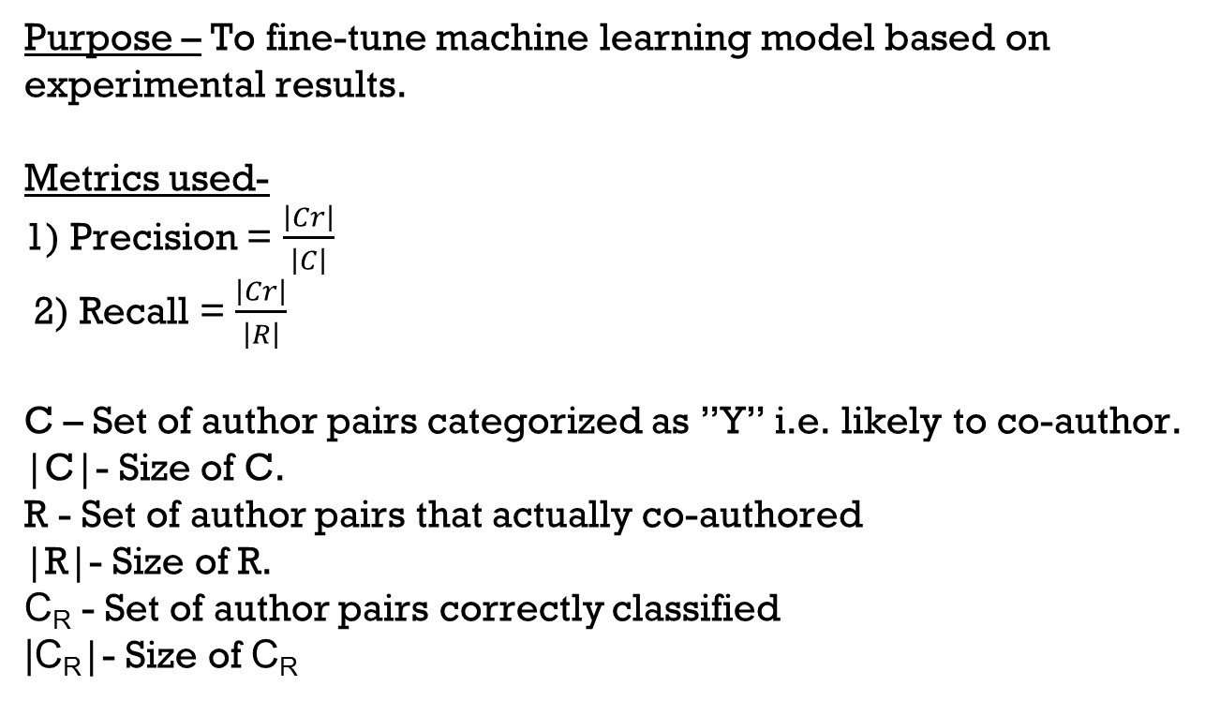
Analysis of findings
Purpose – To fine-tune machine learning model based on experimental results.
Metrics used-
1) Precision = $\frac{\left|Cr\right|}{\left|C\right|}$
2) Recall = $\frac{\left|Cr\right|}{\left|R\right|}$
C – Set of author pairs categorized as ”Y” i.e. likely to co-author. |C|- Size of C.
R - Set of author pairs that actually co-authored
|R|- Size of R.
C_{R} - Set of author pairs correctly classified
|C_{R}|- Size of C_{R}
MACHINE LEARNING APPROACH
DATA SOURCES
COLLABORATION PROBABILITY USING ML
PERFORMANCE MEASURES
Notes:
Update the html.
This is the experimental result. Need a slide for experimental setup so ppl can repeat

Slide 39
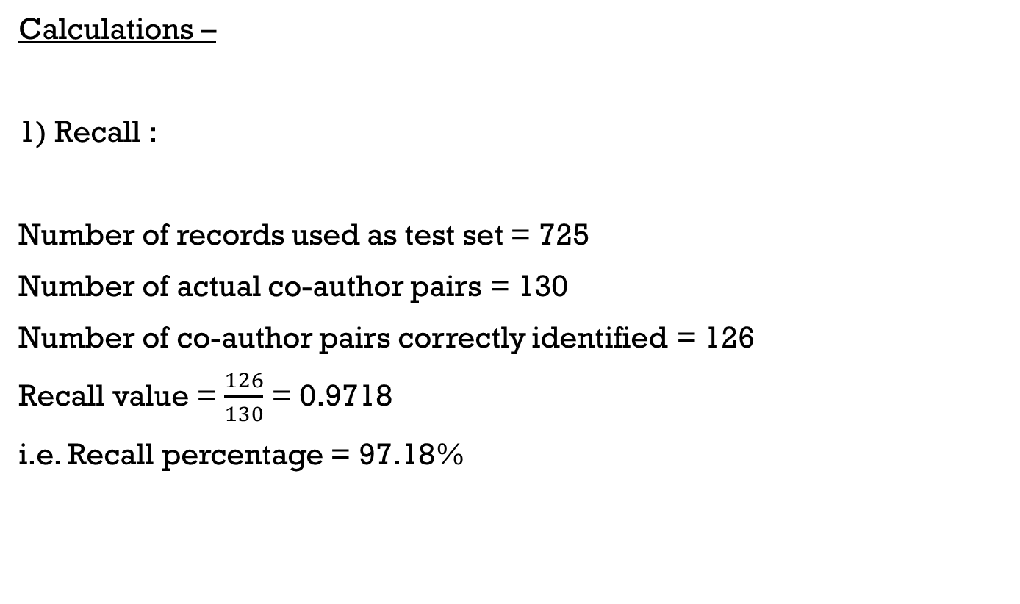
Analysis of findings
Calculations –
1) Recall :
Number of records used as test set = 725
Number of actual co-author pairs = 130
Number of co-author pairs correctly identified = 126
Recall value = $\frac{126}{130}$ = 0.9718
i.e. Recall percentage = 97.18%
MACHINE LEARNING APPROACH
DATA SOURCES
COLLABORATION PROBABILITY USING ML
PERFORMANCE MEASURES
Notes:
Update the html.
This is the experimental result. Need a slide for experimental setup so ppl can repeat

Slide 40
Analysis of findings
Calculations –
2) Precision :
We used publications published after 2008 to calculate precision
Number of records = 351
Number of co-author pairs predicted = 109
Number of actual co-author pairs = 25
Precision value = 1- ( (109−25)/351) = 0.7606
Precision percentage = 76.06%
MACHINE LEARNING APPROACH
DATA SOURCES
COLLABORATION PROBABILITY USING ML
PERFORMANCE MEASURES
Notes:
Update the html.
This is the experimental result. Need a slide for experimental setup so ppl can repeat

Slide 41
demo

Slide 42
Team Practices
TECHNOLOGIES LEARNT
CHALLENGES FACED
WORK METHODOLIGIES

Slide 43
TECHNOLOGIES used
Java (for bulk of development)
MySQL (storage of data)
Python (Machine learning algorithms)
Java Play! (MVC framework for REST API’s)
Notes:
Update the html.
This is the experimental result. Need a slide for experimental setup so ppl can repeat

Slide 44
PRACTICES LEARNT AND USED
Agile software engineering practices
Development with modified scrum
Iterative machine learning process
Project management
Database management
Notes:
Update the html.
This is the experimental result. Need a slide for experimental setup so ppl can repeat

Slide 45
CHALLENGES FACED
Recovering last year’s work
Availability of Sponsor during Government shutdown
Integration with python based VisTrails tool
Unavailability of APIs
Limited dataset
Unavailability of required algorithms on HANA due to license issues
Missing data from entries in DBLP
Notes:
Why DBLP?

Slide 46
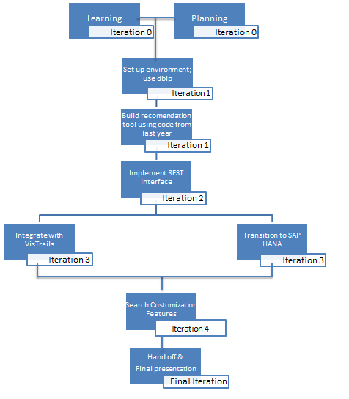
WORK METHODOLIGIES
Agile Process:
Work Breakdown Structure

Slide 47
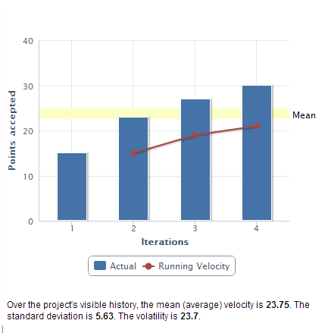
Progress tracking
Project Velocity Chart

Slide 48
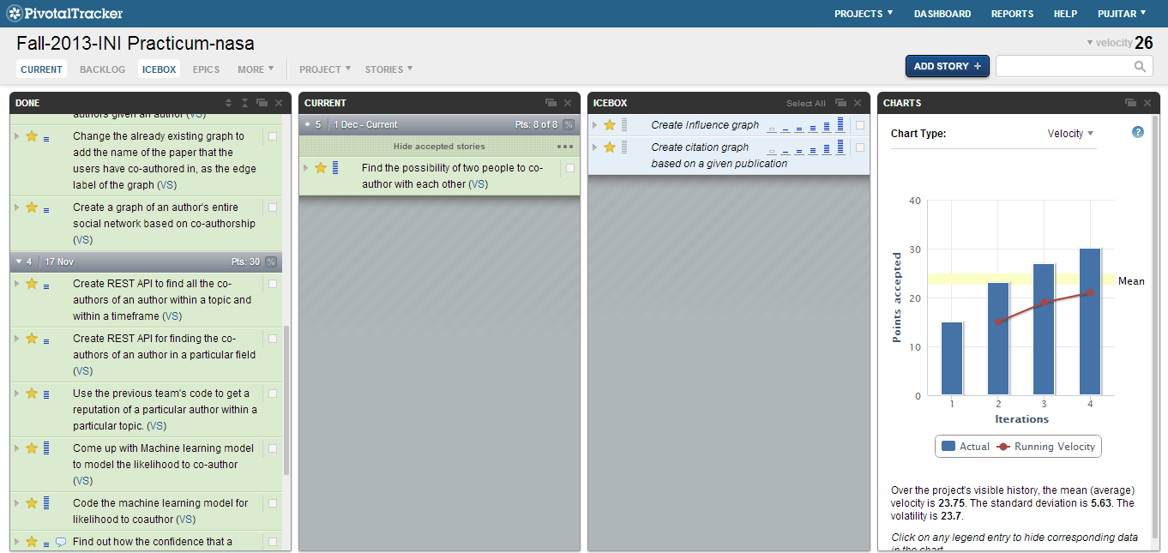
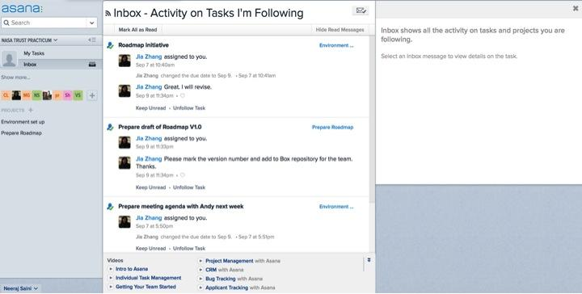
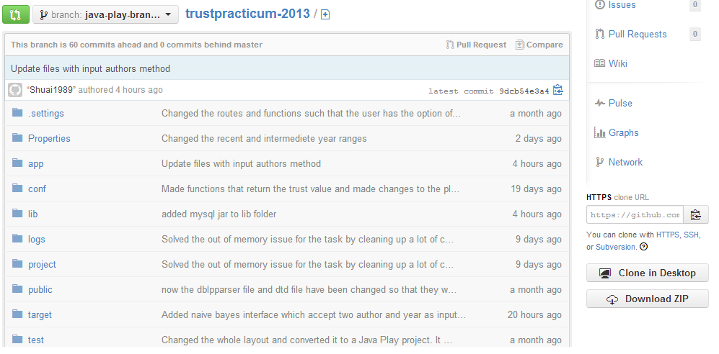
tools
Pivotal Tracker
ASANA for Project Management
Git Repository
Notes:
Include ASANA

Slide 49
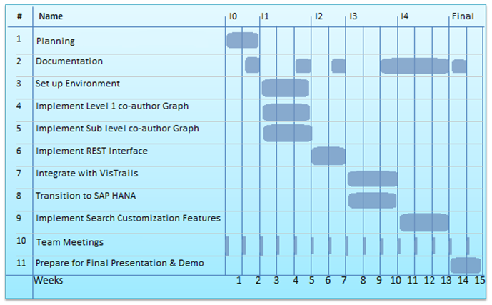
Milestone chart
Milestone Chart
Agile
Weekly Meetings

Slide 50
Lessons Learned

Slide 51
Lessons Learned
Importance of correctness, completeness and clarity of documentation for continuation of projects
Dynamics of working on a research project
Experience of working with a real client
Business exposure to the scientific research community

Slide 52
CONCLUSION

Slide 53
Conclusion
We built a recommendation engine that predicts the probability of collaboration between researchers. With its visualization and analysis tools, it can be used to leverage human-trust to software-trust.
Project Hand-off deliverables
Technical Report
User Guide
Engineering Handbook
Code

Slide 54
FUTURE WORK

Slide 55
Future Work
Leverage time dependencies
Include data from user home pages, to find affiliation similarity.
Customize the code for earth science publication records
Implement user feedback system (Thumbs-up Thumbs-down)
Leverage the model to recommend workflows for software reuse

Slide 56
References
[1] Jia Zhang et. al, “A Technique of Analyzing Trust Relationships to Facilitate Scientific Service Discovery and Recommendation paper”, in Proceedings of IEEE 10th International Conference on Services Computing, 2013.
[2] Yu Xu, “An Efficient Trust Propagation Scheme for Predicting Trustworthiness of Service Providers in Service-Oriented Social Networks”, in IEEE 20th International Conference on Web Services, 2013.
[3] Min Gong, “Recommending Web Service Based on User Relationships and Preferences”, in IEEE 20th International Conference on Web Services, 2013.
[4] Xiaoming Zheng, “Modeling the Dynamic Trust of Online Service Providers using HMM”, in IEEE 20th International Conference on Web Services, 2013.
[5] Lina Yao, “Recommending Web Services via Combining Collaborative Filtering with Content-based Features”, in IEEE 20th International Conference on Web Services, 2013.
[6]NASA Earth Exchange, http://data.nasa.gov/nasa-earth-exchange/#sthash.IyTeGroD.dpuf
[7]DBLP Computer science biblography, http://dblp.uni-trier.de/xml/

Slide 57
Q&A

